Slide 1
Decrypting Deep Learning

Slide 2
Deep Learning steps are same as ML
Deep Learning uses Neural Networks

Slide 3
Machine Learning Building Steps
1) Problem Identification
2) Data Collection
3) Data Preparation
4) Model Selection
5) Model Training/ 6)Hyperparameter Tuning
7) Model Evaluation
Repeating Steps 5-7

Slide 4
Deep Learning Applications: NLP and Computer Vision

Slide 5
Deep Learning Steps
1) Problem Identification
2) Data Collection + Data Augmentation
3) Data Preparation
4) Model Selection
5) Model Training/ 6)Hyperparameter Tuning + Feature Engineering
7) Model Optimization
Model Evaluation

Slide 6
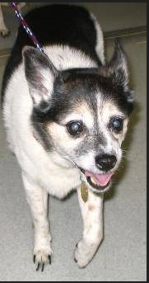

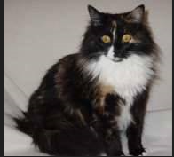
ML Step 1 : Problem Identification
Classify Toxic Comments
Multilabel Text Classification: “Hello” vs “#$%% off”
Toxic, Severely Toxic, Identity-Hate, Threat, Obscene, Insult
Classifying Animal pictures
Multilabel Image Classification

Slide 7
Deep Learning Toolkits
Python, Jupyter Noteboks
Text Comments: Pytorch Lightning
Images: Keras, Tensorflow

Slide 8
ML Step 2: Data Collection
Text Comments: Kaggle Competition
https://www.kaggle.com/c/jigsaw-toxic-comment-classification-challenge
Images: Local Directory

Slide 9
Data Augmentation
Increasing your dataset size through common methods

Slide 10
Data Augmentation
Text Comments: Translating Language from English to French and back to English
This ends up changing the word makeup of sentence, while keeping meaning
Images: Rotating Image, Transposing image
Increases our dataset size with images look like taken from different angle

Slide 11
ML Step 3: Data Preparation
Text Comments: Pytorch Dataset, DataLoader
Image: Keras method to load from directory

Slide 12
ML Step 3: Data Preparation
Splitting up data for Training, Testing, Evaluation
Text Comment: SKLearn Train_test_split can be used with Pytorch
Image: Same Keras method that loads data splits it

Slide 13
ML Step 4: Model selection
Text Classification: BERT Tokenizer + Simple Linear NN
2D CNN

Slide 14
ML Step 5/6: Model Training/Hyperparameter Tuning + Feature Space Engineering
Train Neural Network Models over the course of multiple epochs
Input Data is split and fed in by batches.
Input is turned into numeric format
Inputs are fed through different layers in a forward pass
Loss function informs the model how well it’s doing
Based on loss, Backpropagation recomputes NN weights and Biases
Added benefit: Weights and Biases that determine Features are also optimized

Slide 15
Feature Space Engineering
Neural Networks need numeric inputs
Words are not Numbers
Images are not Numbers
How do we get this data into numeric format

Slide 16
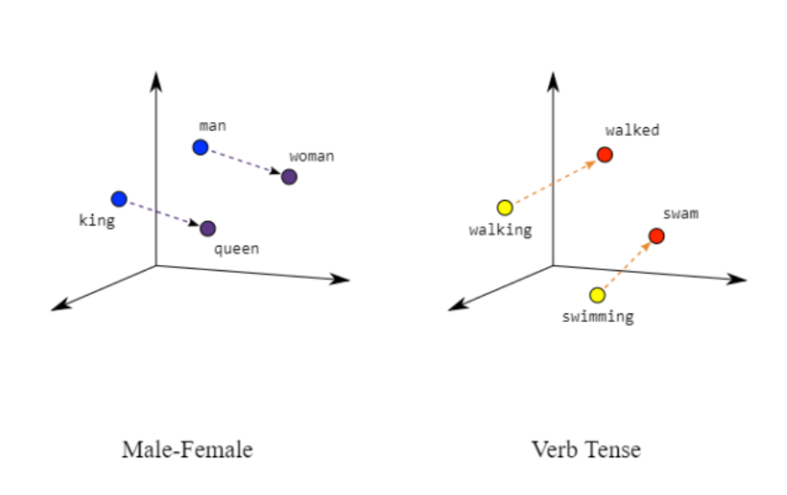
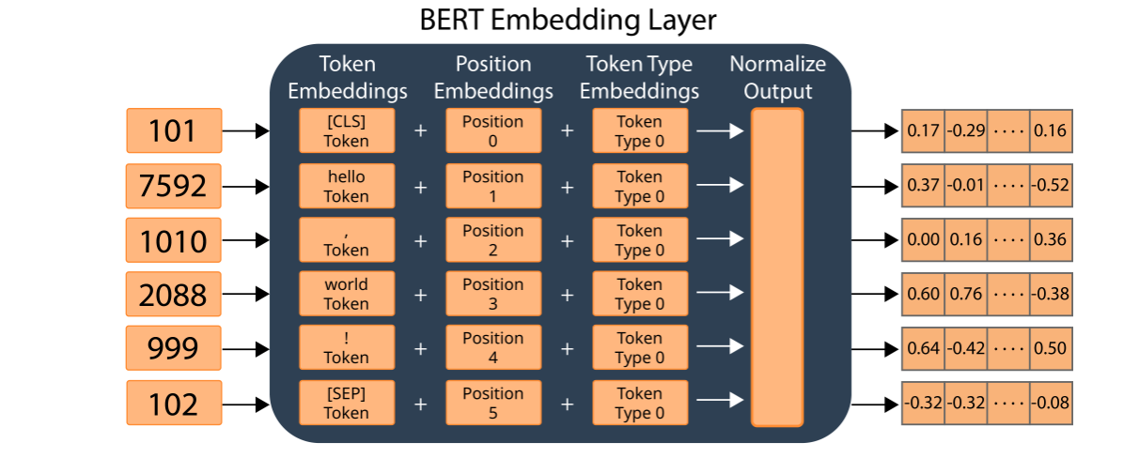
NLP Embeddings
Embeddings allow us to represent Text with Numbers
Text is positioned in a high dimensional space
Similar terms are closer in distance (Euclidean)
BERT provides us Rich Contextualized Embeddings that understand language
During Training BERT embeddings are being fine tuned and optimize for the down stream classification problem

Slide 17
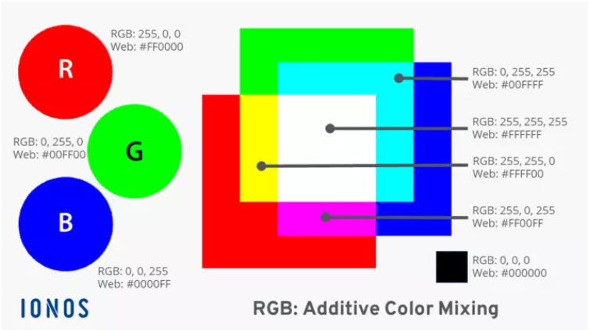
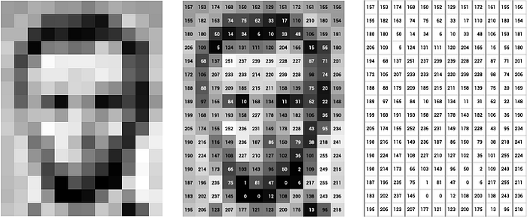
Numeric Representation of images
Images are represented by an area of Pixels
Each pixel has a color, each color can be represented by numbers

Slide 18
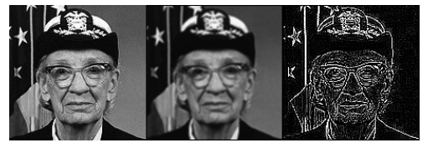
Feature Extraction in Computer Vision
Convolution Filters are applied over images
Backpropagation optimizes Layer of Convolution Filters for Problem
Convolution Filter determines feature space
https://youtu.be/KuXjwB4LzSA?si=R8vKh9LylQ0p268f
Applying Photo effect Filters

Slide 19
Model Optimization
Done through Backpropagation
Minimizing Loss function
Loss function provides us Gradient to recompute Weights and Biases
Cross Entropy Loss: Difference between Predicted distribution by model, True distribution of Labels
Toxic Comments: Binary CrossEntropy
Animal Classification: Sparse Categorical CrossEntropy

Slide 20
ML Step # 7: Model Evaluation
Evaluation is done by calculating the percentage of labels accurately predicted by model
Accuracy
Precision – Recall
ROC-AUC
Confusion Matrix

